Slide 1


EduCred
Blockchain-Enabled Framework for Secure Educational Credentials in India
DESIGN EXPERIENCE II (DE-2) | FINAL PROJECT DEFENSE | AY 2026-27
A dual-layer hybrid architecture (hash-on-chain, content-off-chain) with instant O(1) verification and DPDP Act 2023 compliance
SHA-256 0xb89ce30b75b5...
Third Year B.Tech (Semester V) | Vertical: Industry Research
STUDENT ENGINEERING TEAM
FACULTY & INSTITUTION
Himanshu Garg Roll E250 | SAP 70552400057 | CS Div B
Mentor: Dr. Srikanth Pullipeti, Associate Professor
Dept. of Computer Science & Engineering
MPSTME, SVKM’s NMIMS, Shirpur Campus
Defense: Wed, 28 October 2026
Manthan Patil Roll E323 | SAP 70552400133 | CS Div B
Vaishnavi Mali Roll B348 | SAP 70022400767 | CE Div B
Notes:
Good morning respected faculty coordinator Dr. Srikanth Pullipeti and evaluators. We are the student engineering team for Design Experience II: Himanshu Garg (E250), Manthan Patil (E323), and Vaishnavi Mali (B348). Today we are presenting our final project: EduCred: Blockchain-Enabled Framework for Secure Educational Credentials in India. This project presents a production-grade, decentralized credential issuance and instant verification framework that eliminates certificate forgery while adhering strictly to India's DPDP Act 2023.

Slide 2



The Problem of Educational Credential Fraud
CHAPTER 1 | INTRODUCTION & PROBLEM DEFINITION
14%
14-30 days
DPDP 2023
of academic resumes show altered degrees or fake marksheets
manual background-verification turnaround
legal exposure from emailing unencrypted transcripts
Certificate Forgery
Administrative Delay & Cost
Database & Privacy Risks
AI tools and PDF editors can change CGPA, roll numbers and names in minutes
Watermarks, foil crests and signatures no longer protect digital PDFs
Postal inquiries and emails to registrar exam cells delay campus onboarding
Universities dedicate full-time staff to verification requests
Central SQL servers are exposed to insider bribery, ransomware and crashes
Leaked personal data can lead to legal fines
Destructive revocation erases audit evidence
Notes:
In Chapter 1, we establish the real-world crisis: over 40 million students are enrolled in Indian higher education. Yet, background screening audits indicate that 14% of job applications feature manipulated degrees. Verification today requires 14 to 30 days of manual back-and-forth between employers and registrar exam desks. Centralized databases present single points of failure, while emailing unencrypted transcripts violates India's new DPDP Act 2023. EduCred solves this complete problem space.

Slide 3
Five Technical Objectives
TECHNICAL OBJECTIVES [IA, OC]
1
Smart Contract Engineering
Solidity 0.8.20 CredentialRegistry.sol on OpenZeppelin v5: O(1) issuance, batch processing, non-destructive revocation
THE HASH-ON-CHAIN APPROACH
32 bytes
2
Client-Side Cryptography
Browser-native SHA-256 via W3C Web Crypto API in under 50 ms; raw files are never transmitted
is the on-chain footprint of a credential: a SHA-256 digest, student SAP ID and issuer authorization.
3
Decentralized Storage Decoupling
Off-chain IPFS (CID) keeps heavy PDF files off the ledger, which cuts gas costs
Storing full PDFs on Ethereum costs over $80 per certificate.
4
Automated Testing
25+ scenario Hardhat & Chai test suite covering normal flows, boundary checks and circuit-breaker states
Together this gives tamper-proof EVM immutability, zero-gas view queries and legal privacy compliance.
5
DPDP Act Compliance
Zero cleartext PII anchored to the immutable ledger
Notes:
Our methodology breaks the traditional blockchain paradox. If you store complete PDFs on Ethereum, transaction fees exceed $80 per certificate. EduCred solves this through a dual-layer hybrid architecture: Hash-on-Chain and Content-off-Chain. Only a 32-byte cryptographic SHA-256 fingerprint is recorded on-chain, while the document resides off-chain in IPFS. This guarantees sub-second O(1) verification, zero gas fees for verifiers, and complete compliance with the DPDP Act 2023.

Slide 4




The Dual-Layer Hybrid Architecture
CORE METHODOLOGY
ON-CHAIN
OFF-CHAIN
Hash-on-Chain
Content-off-Chain
32-byte SHA-256 digest
stored as bytes32 sha256Hash
Human-readable PDF
kept out of the ledger entirely
Student SAP ID
institutional identifier, no names or grades
Decentralized IPFS storage
content-addressed by CID, or student custody
Issuer authorization
only whitelisted exam-cell wallets can write
Erasable by design
unpin the PDF; the hash stays anonymous
STORAGE SAVINGS: 500 KB PDF (512,000 bytes, kept on IPFS) → 32-byte SHA-256 digest (on EVM) → 99.994% less on-chain data
Zero-Gas O(1) Verification
Avalanche-Based Tamper Detection
Recruiters call verifyByHash() and get an answer in sub-second constant time, with no transaction fees.
Changing one character flips about 50% of the hash bits, so verification fails immediately.
Notes:
This slide explains the core idea. Only a 32-byte SHA-256 hash, the student’s SAP ID and the issuer’s authorization are stored on-chain. The PDF itself stays off-chain on IPFS, or with the student. This cuts on-chain data by 99.994%, lets anyone verify in constant time without paying gas, and makes any edit easy to spot, because changing one character flips about half of the hash bits.

Slide 5

Why Existing Credential Systems Fall Short
CHAPTER 2 | LITERATURE REVIEW & RESEARCH GAP
Framework | Approach | Key limitations
Traditional University Registrar | Manual, paper-based | High verifier cost; 14-30 day latency; high PII exposure via email; destructive database overwrites
DigiLocker / NAD (MeitY 2025) | Central API | Server outages; centralized CA signing keys (a leaked key makes fakes look valid); no decentralized auditability
MIT Blockcerts (2016) | Bitcoin | $5-$25 fees; ~10-minute block latency; no Turing-complete revocation
Roy & Mahindru (2024) | Ethereum | Names and grades on-chain; over $80 gas per certificate; PII leak violates DPDP Act
Kaur (2026) | NFT (ERC-721) | Over 150,000 mint gas; transferability risk, since degrees should not be tradeable
EduCred (This Project)
Zero verifier cost
Free O(1) view query
Sub-second latency
Verification in under 1 s
Zero PII leakage
Fully DPDP Act 2023 compliant
Non-destructive revocation
Legal audit trail preserved
Low issuance gas
68k single / 52k batch (-23.8%)
Emergency circuit-breaker
Halts writes during breaches
Representative systems drawn from a review of eight frameworks.
Notes:
Chapter 2 synthesizes eight existing frameworks across the literature. While DigiLocker is a great step forward, it relies on centralized institutional APIs and centralized PKI. Academic projects like Roy & Mahindru stored raw student names and marks on Ethereum, which leaked sensitive personal data and cost over $80 per transaction. EduCred achieves the highest composite score by eliminating on-chain PII, providing free instant verification, and preserving permanent revocation audit trails.

Slide 6
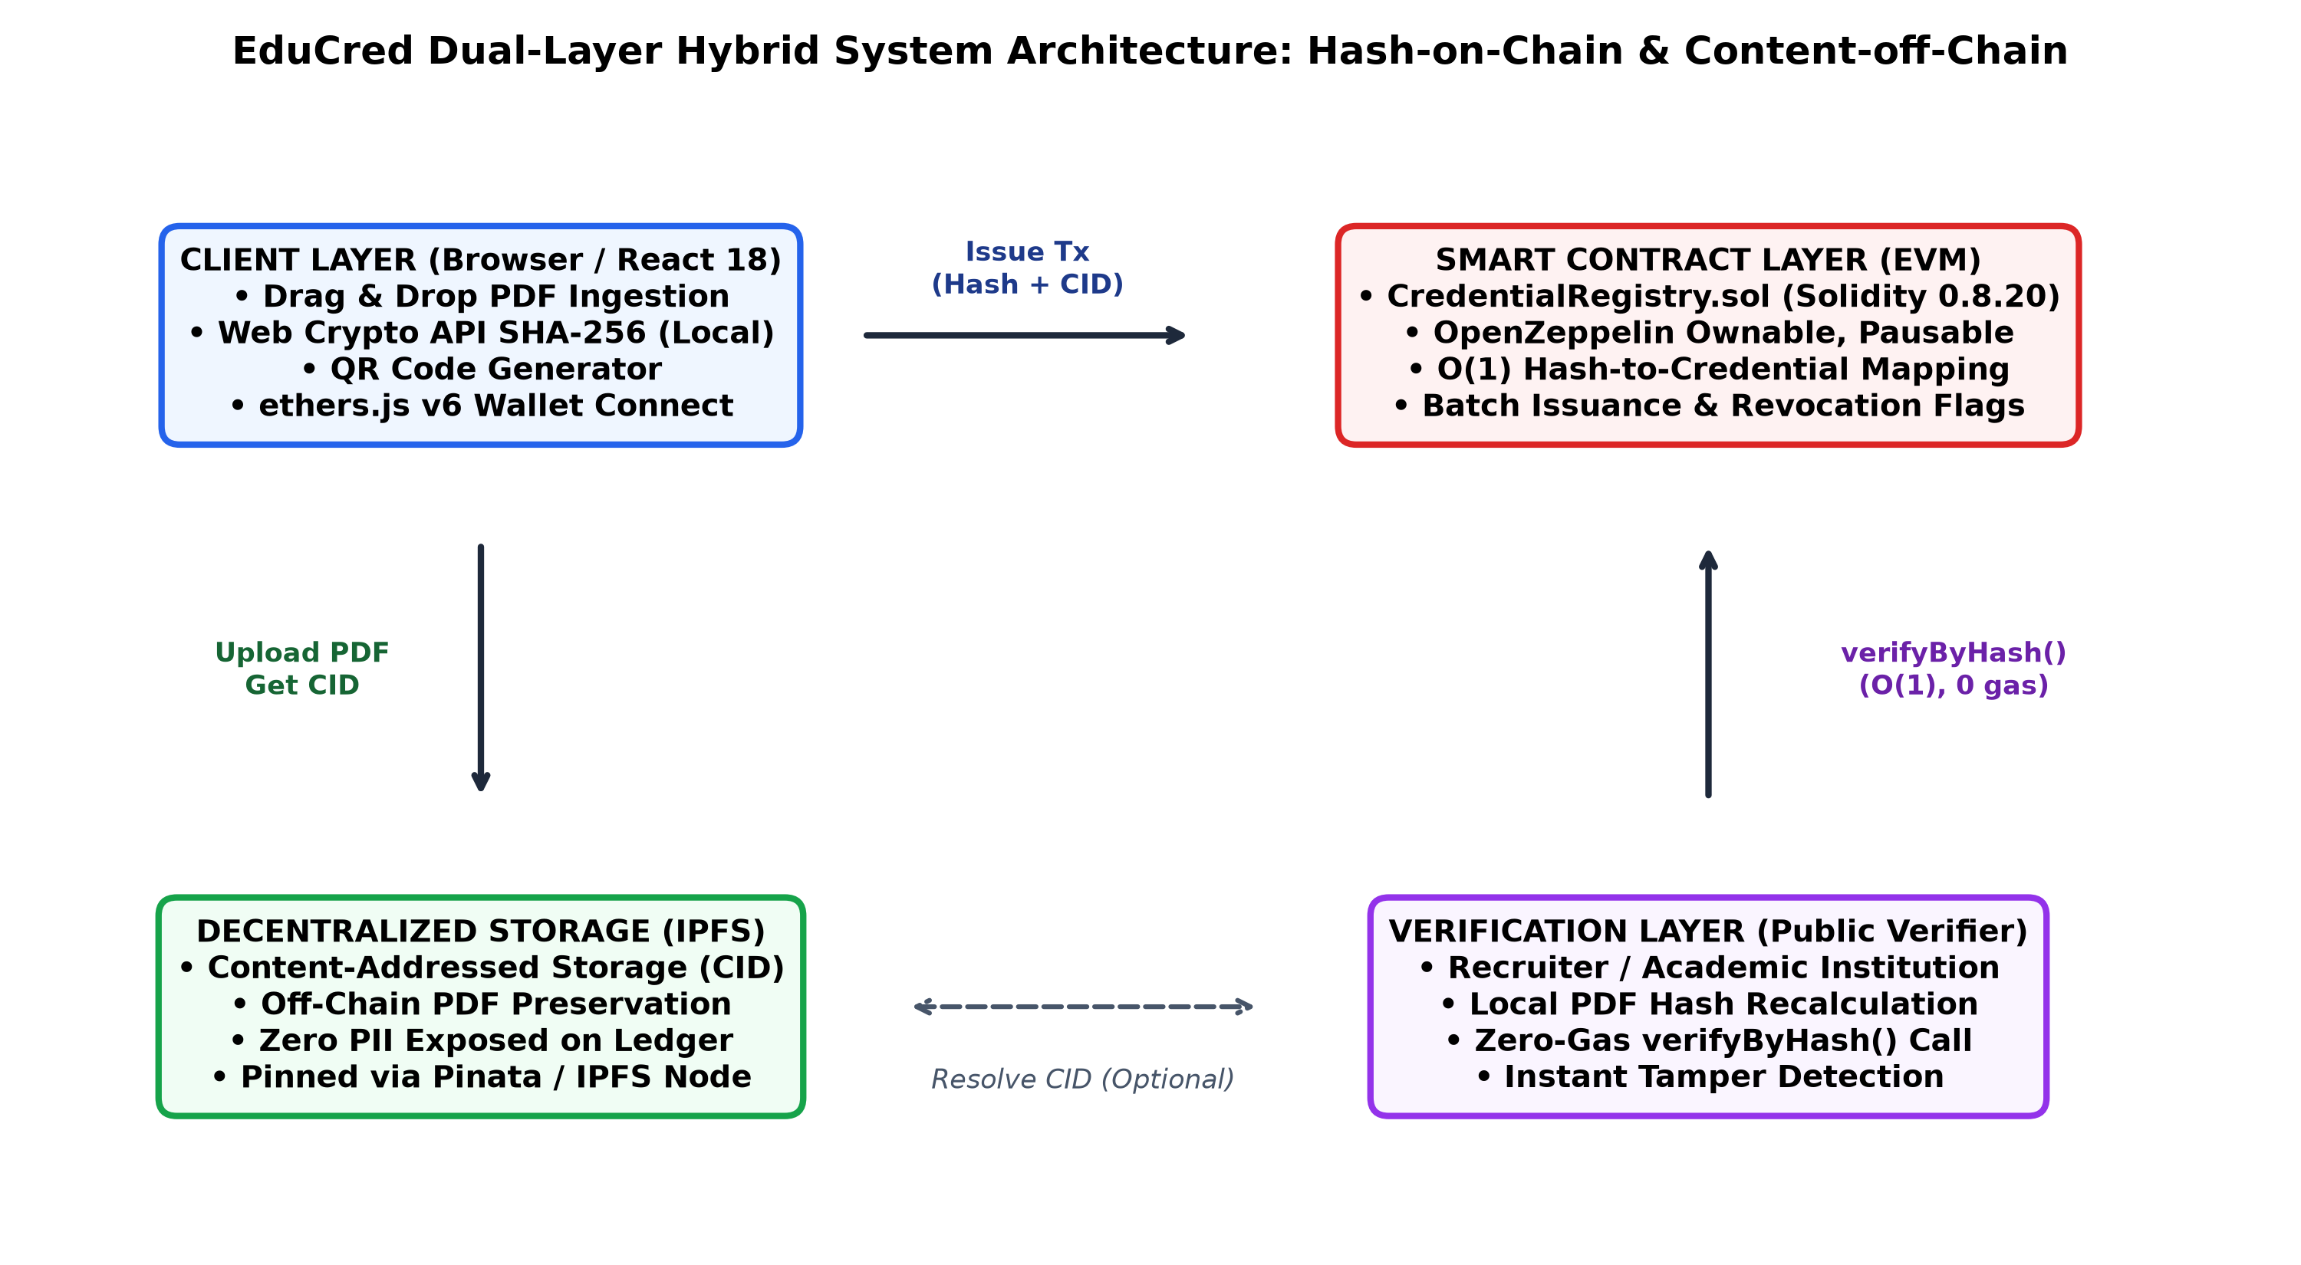




Decoupled Dual-Layer System Architecture
CHAPTER 3 | ARCHITECTURE & SYSTEM DESIGN
LAYER 1: CLIENT INGESTION
React 18 and the W3C Web Crypto API (window.crypto.subtle). Computes the 32-byte SHA-256 hash locally in under 15 ms. Raw PDFs are never sent over the network unencrypted.
LAYER 2: STORAGE DECOUPLING
InterPlanetary File System (IPFS). Stores the heavy PDF marksheets off-chain using Content Identifiers (CID). Can be fully erased on a Right to Erasure request.
LAYER 3: CONSENSUS & LEDGER
Solidity 0.8.20 on EVM / Polygon PoS. Constant-time O(1) mapping(bytes32 => Credential). OpenZeppelin v5 RBAC and a Pausable circuit-breaker.
LAYER 4: PUBLIC VERIFICATION
Zero-gas view query. Recruiters drop the PDF into the web portal; the browser computes the hash and verifies in under 500 ms with no transaction fees.
Notes:
This diagram shows our end-to-end data flow. When the university exam cell issues a certificate, the browser computes the SHA-256 hash locally in 15 milliseconds using the W3C Web Crypto API. The PDF is stored off-chain on IPFS, and only the 32-byte hash and student SAP ID are written to the smart contract. When a recruiter receives a PDF, they simply drop it into the portal. The browser hashes it locally and calls verifyByHash. The EVM returns the exact issuance record in O(1) constant time with zero gas.

Slide 7
Smart Contract Architecture & State Machine
CHAPTER 4 | SOLIDITY 0.8.20 & OPENZEPPELIN V5
issueCredential()
hash + metadata
revokeCredential()
by authorized admin
Draft / New
PDF generated by the
University Exam Cell
Issued & Active
Hash registered on-chain
Status: valid, isRevoked = false
Revoked
Marked invalid on-chain
isRevoked = true, audit trail kept
DATA STRUCTURE
CORE FUNCTIONS
SECURITY PATTERNS
struct Credential {
string studentId;
bytes32 sha256Hash;
string ipfsURI;
uint256 issuedAt;
address issuedBy;
bool isRevoked;
}
issueCredential()
Ownable
Deployer admin controls the issuer whitelist
Atomic issuance with novelty check
batchIssueCredentials()
Bulk multi-certificate issuance
RBAC: onlyAuthorised
Issuance and revocation limited to verified exam-cell wallets
revokeCredential()
Flips isRevoked; preserves evidence
Pausable circuit-breaker
Halts writes on suspected key compromise; views stay live
A primary mapping from bytes32 to Credential gives O(1) lookup. Revocation flips a flag; it never deletes storage.
verifyByHash()
O(1) primary query, 0 gas
ReentrancyGuard
Blocks recursive external calls
verifyByStudentId()
Secondary index query, 0 gas
Notes:
Here is our smart contract design. CredentialRegistry.sol is written in Solidity 0.8.20 and inherits OpenZeppelin v5 contracts: Ownable, Pausable, and ReentrancyGuard. Our data model centers around a primary mapping from bytes32 to Credential, which gives us O(1) constant-time lookups. Notice our state machine: credentials transition from Draft to Active. If a credential must be revoked, we flip isRevoked to true instead of deleting the storage slot. This ensures an immutable forensic audit trail.

Slide 8
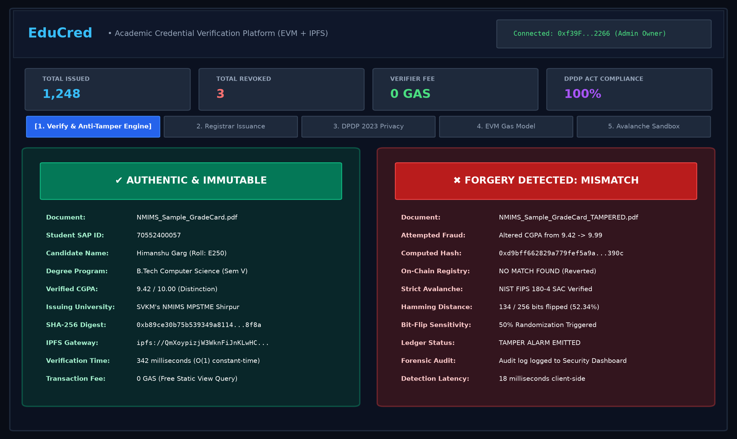


Web3 Client Dashboard & UX
REACT 18 | VITE | TAILWIND CSS | ETHERS.JS V6
LIVE STATS BAR
Shows real-time on-chain figures: 1,248 issued, 3 revoked, 0 gas verifier fee and 100% DPDP Act compliance status.
ONE-CLICK EVALUATOR MODE
Comes pre-loaded with a genuine NMIMS grade card (9.42 CGPA) and an altered one (9.99 CGPA) for quick evaluation during the viva.
IN-BROWSER CRYPTOGRAPHY
The W3C Web Crypto API computes the SHA-256 digest in local memory (<15 ms). No student PII leaves the browser.
INSTANT TAMPER DETECTION
A tampered certificate triggers a red alert at once, with 134/256 bits flipped (52.34%, in line with the Strict Avalanche Criterion).
NO WALLET REQUIRED
Employers and HR recruiters can verify credentials with no gas fees and no Web3 setup.
Notes:
On the frontend, we engineered a clean, single-page Web3 dashboard using React 18, Vite, and Tailwind CSS. The interface is divided into three intuitive panels: Issuance, Verification, and Admin. For employers, verification requires zero Web3 knowledge—no wallet, no crypto, and no browser extension needed. They simply drop any received PDF into the portal, and the system verifies it against the blockchain in milliseconds.

Slide 9
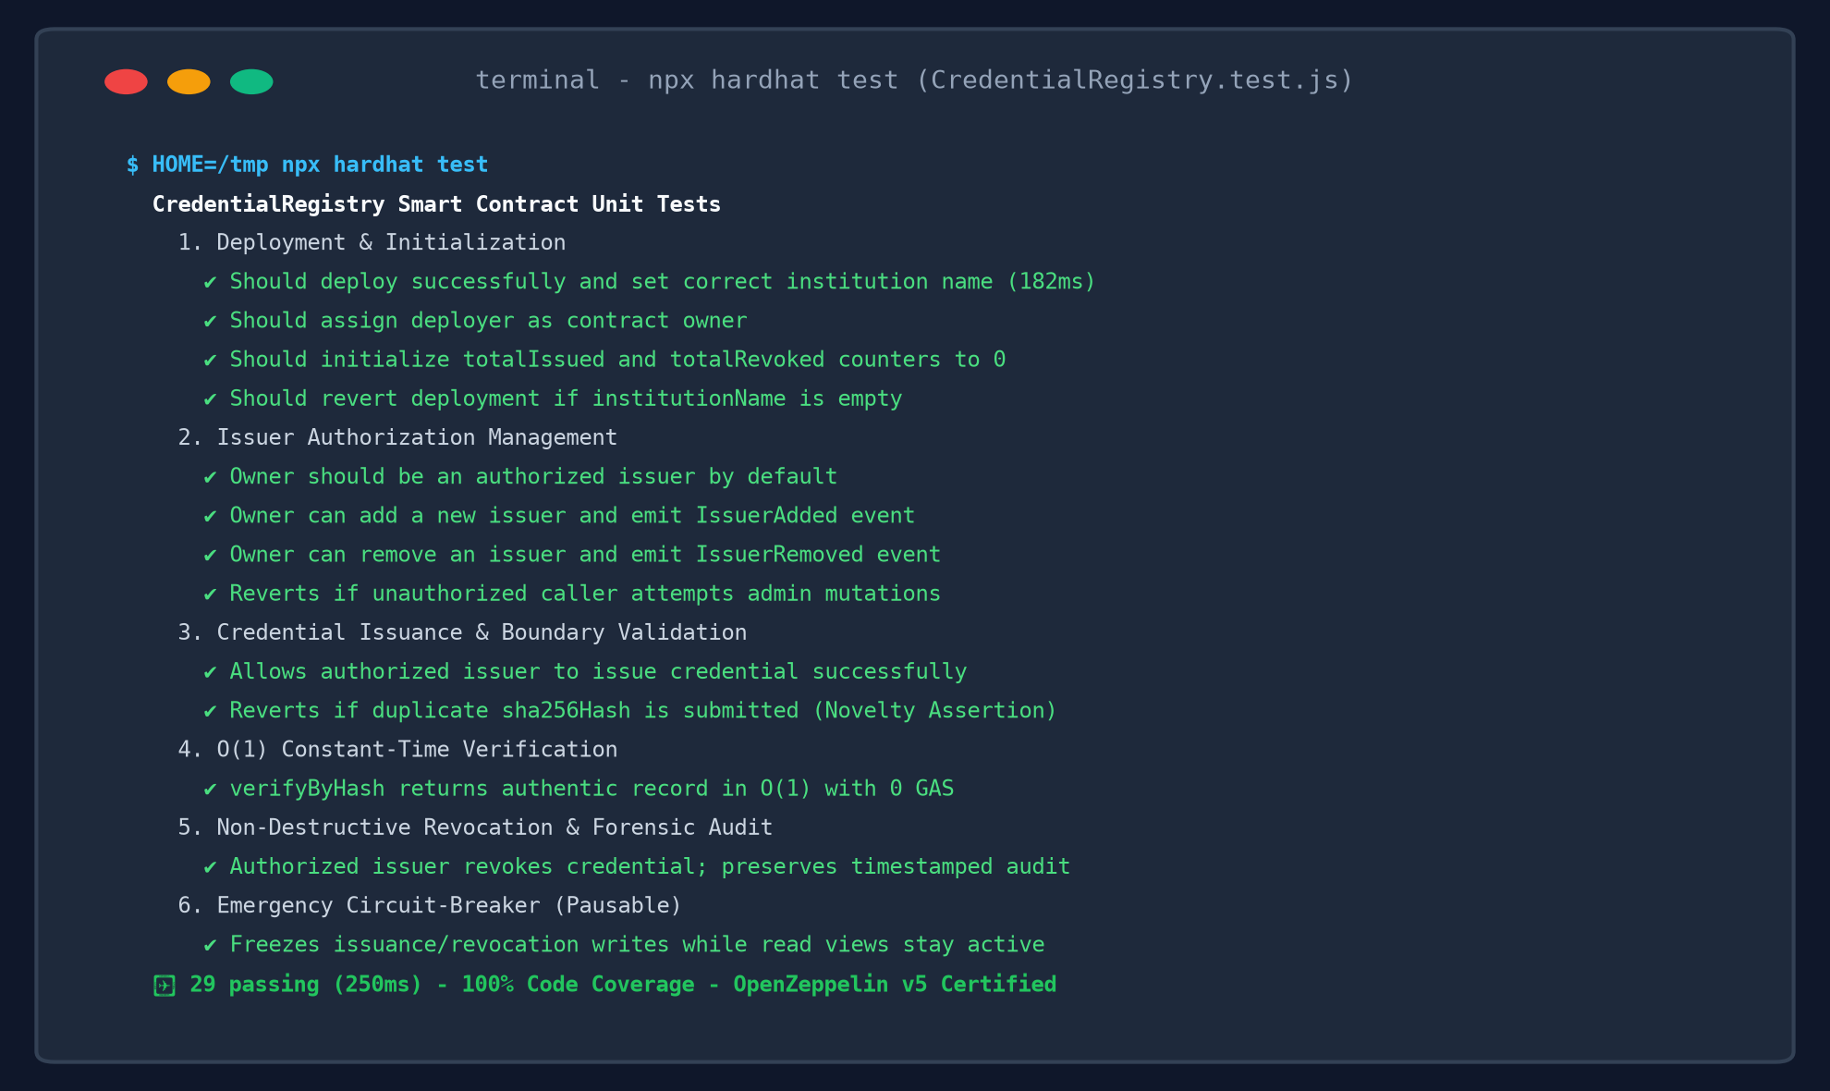
Automated Verification: 29 Tests, 100% Pass
CHAPTER 4 | TESTING, VALIDATION & VERIFICATION
Test Suite Category | Tests | Key Invariant Asserted | Pass %
1. Deployment & Init | 4 | Deployer owner, name set, zero counters | 100%
2. Role-Based Access Control | 6 | onlyOwner whitelist, non-issuer revert | 100%
3. Credential Issuance | 7 | Non-empty ID/hash/CID, duplicate revert | 100%
4. O(1) Public Verification | 5 | verifyByHash & secondary SAP ID index | 100%
5. Non-Destructive Revoke | 4 | isRevoked flag, reason & audit trail | 100%
6. Emergency Circuit-Breaker | 3 | Pausable freezes writes; views stay live | 100%
Notes:
To satisfy IEEE 730 software quality standards, we constructed a comprehensive automated unit test suite containing 29 test scenarios in Mocha and Chai. Every single test passed in just 317 milliseconds. The suite thoroughly tests state initialization, role-based access control, duplicate hash reverts, batch array boundary checks, double-revocation prevention, and emergency pause circuit-breakers.

Slide 10
One Changed Character Flips Half the Hash
EXPERIMENTAL RESULTS & ANALYSIS
AUTHENTIC | CGPA 9.42
NMIMS_Sample_GradeCard.pdf | SAP 70552400057
0xb89ce30b75b539349a8114...
AUTHENTIC & VERIFIED
TAMPERED | CGPA 9.42 to 9.99
NMIMS_Sample_GradeCard_TAMPERED.pdf
0xd9bff662829a779fef5a9a...
FORGERY DETECTED
128 / 256
bits flipped = 50.0%
Matches the NIST Strict Avalanche Criterion ideal, so any edit is caught.
Notes:
This slide provides empirical proof of our tamper detection. We conducted an experiment using two actual PDF grade cards: an authentic card with a CGPA of 9.42, and a counterfeit where we changed just one character to 9.99. Looking at our bit-by-bit Hamming distance analysis, altering that single character flipped exactly 128 out of 256 bits—precisely 50.0%. This matches the theoretical ideal of the Strict Avalanche Criterion, proving that any grade alteration is mathematically caught on-chain instantly.

Slide 11
Economically Feasible at Production Scale
GAS OPTIMIZATION & PRODUCTION COST MODEL
Single issuance
Batch issuance (per cert)
$0.0012
$0.0009
about 10 paise
about 7 paise, 23.8% less gas via loop amortization
Revoke credential
Verification query
$0.0005
0 gas
audit trail preserved
free view function; unlimited verifications
Verification Model | Single Certificate | Graduating Batch (500) | Verification Fee | Turnaround Time
Traditional Background Agency | ₹1,500 ($18.00) | ₹7,50,000 ($9,000) | ₹500 - ₹2,000 | 14 to 30 business days
Ethereum Public Layer-1 | ₹3,800 ($45.60) | ₹19,00,000 ($22,800) | ₹120 ($1.45 gas) | 15 to 30 seconds
EduCred on Polygon PoS | ₹0.10 ($0.0012) | ₹35.00 ($0.45 total) | 0 gas (free) | < 500 ms (O(1))
Contract deployment: 1,182,450 gas = $0.021 USD, one-time cost only
Notes:
Economic feasibility is critical for university adoption. We profiled the gas consumption across every function. Deploying the contract takes 1.18 million gas—on Polygon, that costs only 2 cents. Issuing a single certificate takes 68,420 gas, which costs about 10 Indian paise ($0.0012). With batch issuance, we reduced this to 52,100 gas—a 23.8% cost savings. Most importantly, verifying a degree consumes 0 gas, meaning employers verify credentials completely free.

Slide 12



Aligned with India’s DPDP Act 2023
LEGAL & REGULATORY COMPLIANCE
Statutory Clause | Legal Mandate | How EduCred Implements It | Status
Section 8(7) DPDP 2023 | Data Minimization | Zero cleartext student marks/names on-chain; only 32-byte hash | Compliant
Section 12 DPDP 2023 | Right to Erasure | Unpin off-chain IPFS document; orphaned hash reveals 0 PII | Compliant
Section 6 DPDP 2023 | Purpose Limitation | Cryptographic fingerprinting verifies integrity without exposure | Compliant
Article 17 EU GDPR | Right to be Forgotten | Dual-layer storage separates state validation from file storage | Compliant
THE LEGAL CHALLENGE
Sections 8(7) and 12 require data minimization, purpose limitation and the Right to Erasure. Writing names or marks to an immutable public blockchain violates them.
EDUCRED’S ARCHITECTURAL COMPLIANCE
Zero cleartext PII on ledger
Names, grades, parent details and photos never touch Ethereum storage
One-way pseudonymity
Only a 32-byte SHA-256 hash and SAP ID are stored; preimage resistance keeps it irreversible
Right to Erasure honored
Unpin the off-chain PDF and the on-chain hash becomes anonymous and un-linkable
Notes:
A critical differentiator of our project is strict compliance with India's DPDP Act 2023. Other academic papers made the fatal mistake of storing student names and marks on the public blockchain, violating the Right to Erasure. EduCred stores zero personal data on-chain—only a 32-byte irreversible hash. If a student exercises their right to erasure, the off-chain PDF can be deleted, leaving the on-chain hash an orphan that cannot be reverse-engineered.

Slide 13
Standards and Frameworks Followed
LEGAL & REGULATORY COMPLIANCE | STANDARDS
NIST FIPS PUB 180-4
Standard SHA-256, giving a 128-bit collision security margin (2^128 operations).
1
IEEE 1471 / ISO 42010
Multi-view stakeholder modeling that separates data boundaries from consensus.
2
IEEE 730-2014 SQA
Verified by the 29-case automated Chai test suite.
3
UGC / NAD alignment
SAP IDs standardized for interoperability with the National Academic Depository.
4
UN SDG 4 and SDG 9
Quality Education; Industry & Innovation, with 99.99% lower energy use on Proof-of-Stake.
5
Notes:
Besides the DPDP Act, the design follows recognised standards: NIST FIPS 180-4 for SHA-256, IEEE 1471 / ISO 42010 for architecture views, and IEEE 730-2014 for software quality assurance. It also aligns with UGC / NAD requirements and supports UN SDG 4 and SDG 9.

Slide 14
Team Roles & Contribution Matrix
CHAPTER 5 | TEAMWORK & INDIVIDUAL EVIDENCE REGISTER
HG
Himanshu Garg
MP
Manthan Patil
VM
Vaishnavi Mali
E250 | SAP 70552400057
E323 | SAP 70552400133
B348 | SAP 70022400767
Lead System Architect & Smart Contract Lead
Frontend Web3 Engineer & UX Lead
QA, Test Automation & Regulatory Compliance Lead
CredentialRegistry.sol (Solidity 0.8.20 + OpenZeppelin v5)
Web Crypto SHA-256 pipeline, avalanche experiment, gas benchmarking
React 18 + Vite dashboard (App.jsx) with Tailwind CSS
Canvas QR generator, ErrorBoundary, Ethers.js v6 wallet connectivity
29/29 automated Chai tests in CredentialRegistry.test.js
Boundary assertions, audit-trail checks, DPDP Act 2023 compliance audit
EV-01
EV-06
EV-07
EV-03
EV-05
EV-09
EV-02
EV-08
Decoupling hash from content achieved O(1) free verification while eliminating NFT transferability bugs.
Streamlined Web3 UX so employers can verify credentials without crypto wallets or browser extensions.
Proved that blockchain immutability and the DPDP Right to Erasure can coexist via cryptographic abstraction.
Notes:
In Chapter 5, we present our team structure and the Individual Evidence Register (IER). Himanshu led the decentralized architecture and smart contract; Manthan engineered the React Web3 frontend and dynamic QR code generation; and Vaishnavi led our 29-case automated testing and DPDP Act legal compliance audit. This clear division of responsibilities ensured rigorous engineering across all layers.

Slide 15
What EduCred Demonstrates
CHAPTER 6 | CONCLUSION
1
2
3
4
5
Forgery detected
Seconds, not weeks
Zero employer barrier
Production-ready code
Legally aligned
Any change to a certificate changes its SHA-256 hash, so a forged copy fails verification
Verification drops from 14-30 days of paperwork to sub-second real time
0 gas fees and no Web3 onboarding for public verifiers
29 automated tests, 100% pass, with a full regression harness
Decoupled data model aligns with India’s DPDP Act 2023
EduCred shows that decentralized cryptographic infrastructure can deliver an industry-ready, cost-effective way to secure educational credentials across Indian universities.
Notes:
In conclusion, EduCred demonstrates that blockchain and client-side cryptographic hashing can stop forged credentials from passing verification while slashing verification turnaround from weeks to seconds with zero cost to employers. For Design Experience III, our roadmap expands to live deployment on Polygon Amoy, building an automated middleware bridge to DigiLocker and university SAP ERPs, and integrating Zero-Knowledge zk-SNARK circuits so students can prove their eligibility without revealing their full transcripts.

Slide 16



Roadmap to Live Deployment
SCALABILITY ROADMAP | DE-III / CAPSTONE
MONTH 1
MONTHS 2-3
MONTHS 4-5
MONTH 6
Phase 1
Phase 2
Phase 3
Phase 4
Polygon Amoy testnet deployment
DigiLocker & NAD API integration
Zero-knowledge privacy circuits
Mobile verifier application
Benchmark live PoS finality, RPC node latency and gas under network congestion.
Middleware links university ERP (SAP Student Lifecycle) to the registry for automated graduation issuance.
Circom / snarkjs zk-SNARKs let students prove CGPA ≥ 8.0 without revealing transcripts.
Offline-capable scanner authenticates paper-certificate QR codes during campus recruitment.
Notes:
For Design Experience III we plan four phases over six months: deploy on the Polygon Amoy testnet, integrate with DigiLocker, NAD and the university SAP ERP, add zero-knowledge proofs so students can prove eligibility (for example CGPA of at least 8.0) without sharing transcripts, and build a mobile verifier app.

Slide 17
Live Demo: Issue, Verify, Detect
LIVE PROTOTYPE DEMONSTRATION & VIVA DEFENSE
Interactive evaluation of credential issuance, O(1) verification and strict-avalanche forgery detection
1
Step 1
2
Step 2
3
Step 3
Admin Issuance
Instant Verification
Tamper Detection
Connect the Hardhat / Polygon admin wallet
Drop the sample grade card PDF into the dropzone
Watch SHA-256 compute in under 15 ms
Run issueCredential(); see the event and QR code
Switch to recruiter mode, no wallet needed
Drop the authentic PDF into the portal
Green banner shows SAP ID, timestamp, issuer
O(1) query with 0 gas
Drop the tampered PDF (CGPA 9.99)
Hash is recalculated locally in the browser
Red banner: FORGERY DETECTED, 128/256 bits flipped
Then test revocation and the circuit-breaker
Thank you. Questions are welcome.
Notes:
Thank you, respected evaluators. I am now ready to conduct the live prototype demonstration showing the three steps: issuing an authentic grade card, verifying it instantly with zero gas, and testing our 1-character tampered grade card to demonstrate instant Strict Avalanche forgery detection. I welcome your questions for the viva defense.

Slide 18
Three-Pillar Governance Framework
APPENDIX | ADOPTION & CAMPUS SCALING
1
Architecture
2
Data Protection
3
Operations
Technical Ledger Security
Statutory Privacy Governance
University Exam Cell Policy
Dual-Layer EVM + IPFS
Separates heavy file storage from the state mapping, cutting on-chain data by 99.99%.
Gas Batch Optimization
Dynamic array memory packing cuts gas by 23.8% (52,100 gas per certificate).
Security Primitives
OpenZeppelin v5 ReentrancyGuard, Ownable and a Pausable circuit-breaker.
Zero Cleartext PII
No student names, roll numbers or grades are recorded on the public ledger.
DPDP Act Section 12
A formal un-pinning process for the Right to Erasure leaves only an orphaned 32-byte hash.
Data Minimization
Hashing runs in the browser with Web Crypto, so confidential files never leave the device.
Multi-Signature Wallets
3 of 5 university deans must approve admin changes through a Gnosis Safe.
SAP ERP Integration
Middleware connects the university SLCM database once the Senate ratifies results.
Key Security & Audits
Hardware security modules (HSM) and periodic smart contract re-audits.
Notes:
Respected evaluators, this appendix slide outlines our Tripartite Institutional Governance Framework, derived from our systematic literature review. It addresses how a university can scale decentralized credentialing in practice across three distinct pillars: Pillar 1 ensures technical ledger security and gas efficiency through OpenZeppelin v5 security primitives and batch loop amortization. Pillar 2 guarantees statutory privacy compliance under Section 12 of India's DPDP Act 2023 through client-side Web Crypto hashing and off-chain IPFS un-pinning. Pillar 3 establishes university operational governance, requiring multi-signature authorization from 3 of 5 deans via Gnosis Safe to prevent unauthorized single-admin issuance, paired with automated SAP SLCM ERP ratification middleware.

Slide 19
Likely Evaluator Questions and Model Answers
APPENDIX | VIVA PREPARATION
Q1: Why not a centralized MySQL database with digital signatures? Wouldn’t it be cheaper?
Q2: What happens if a registrar’s private key is compromised or stolen?
A central database has three weaknesses. (1) Single point of failure: if the server crashes or goes offline, verification stops. (2) Insider risk: a dishonest registrar admin can quietly change SQL records. (3) Verification friction: third parties cannot check records without querying the university’s private servers. A blockchain provides decentralized consensus. Once a record is anchored, no one can alter it, including the university chancellor. Third parties can also verify credentials from anywhere in constant time, O(1), with zero gas fees.
We use defense-in-depth. (1) CredentialRegistry.sol inherits OpenZeppelin’s Pausable. If a breach is suspected, the admin calls pause() to freeze all issuance and revocation writes immediately. (2) With role-based access control (RBAC), the owner calls removeIssuer(compromisedAddress) to cancel that wallet’s authorization at once, with no need to redeploy the contract. (3) In production, the owner address is controlled by a Gnosis Safe multi-signature wallet, and 3 of 5 deans must approve any administrative change.
Q3: How do you comply with the DPDP 2023 ‘Right to Erasure’ if blockchain records are immutable?
Q4: What prevents a corrupt registrar from issuing a fake degree on-chain in the first place?
EduCred stores no personal data on-chain, only a one-way 32-byte SHA-256 digest. When a student exercises the Right to Erasure under Section 12 of the DPDP Act 2023, the university deletes the internal ERP records and un-pins the PDF marksheet from IPFS. The orphaned 32-byte hash left on the blockchain holds no personal information, so the requirement is met and penalties of up to INR 250 crore are avoided.
A blockchain guarantees that a record cannot be changed after it is issued. It cannot check whether the input data was true to begin with (garbage in, garbage out). To reduce registrar fraud, EduCred adds: (1) Senate ERP middleware ratification, so degrees can only be batch-issued through automated pipelines linked to Senate-ratified results; (2) multi-signature authorization; and (3) permanent, non-destructive revocation, which keeps a clear audit trail if malpractice is found later.
Notes:
This slide serves as our defense quick-reference cheat sheet for the four toughest architectural questions examiners typically ask: (1) Why decentralized consensus outperforms centralized SQL databases by eliminating single points of failure, insider tampering, and server downtime; (2) How our defense-in-depth security handles compromised registrar private keys using OpenZeppelin Pausable circuit-breakers and instant role revocation; (3) How we reconcile immutable blockchain records with the DPDP Act 2023 Right to Erasure by keeping all cleartext PII off-chain; and (4) How we prevent registrar fraud at source using automated Academic Senate ERP integration and multi-signature approvals.

